Slide 1
Power Management in Android
Presented by Menna Mohamed and Macrina Ashraf

Slide 2
Agenda
What is Power Management?
Power Management in Linux
Advanced Power Management(APM)
Advanced Configuration and Power Interface(ACPI)
Power Management in Android
App restriction
App standby
Doze
Exemption
Power Management in Android Applications
Lazy First
Use platform features
Tooling
Application restrictions
Improvements in Power Management in Android Pie
App standby buckets
Battery saver improvements

Slide 3
What is Power Management?
It’s a feature that allows the users to control the amount of power consumed by a device they are using with minimal impact on performance.
It enables devices to switch between various power modes, each device with different usage characteristics related to each device’s performance.

Slide 4
Power Management in Linux
The need for power management is not very powerful in Linux.
There is 2 main techniques used in power management in Linux:
Advanced Power Management(APM)
Advanced Configuration and Power Interface(ACPI)

Slide 5
Advanced Power Management(APM)
It’s found in older systems.
Power management is done at Basic Input/Output System(BIOS).
It allows higher-level software to use APM without any knowledge of the hardware interface.
APM can extend the life of system batteries and thereby increases productivity and system availability.

Slide 6
Advanced Configuration and Power Interface(ACPI)
It is supported by modern PCs.
Power Management is controlled by operating system and BIOS.

Slide 7
Power Management in Android
Android keep evolving and adds features to aid in extend battery life.
Android enhancement in battery life:
App Restrictions.
App Standby.
Doze.
Exemptions.

Slide 8
Power Management in Android
App Restrictions: The Platform can offer apps that effect negatively affect on battery life, so user can restrict those app from resources consumption.
App Standby: The platform can adds unused apps in App standby mode, temporarily restricting network access and deferring postpone and jobs for those app.

Slide 9
Power Management in Android
Doze: The platform can enter in a state of deep sleep if users have not actively used their device for extended periods of time.
Exemptions: Preloaded system apps and cloud messaging services are typically exempted from App Standby and Doze by default.

Slide 10
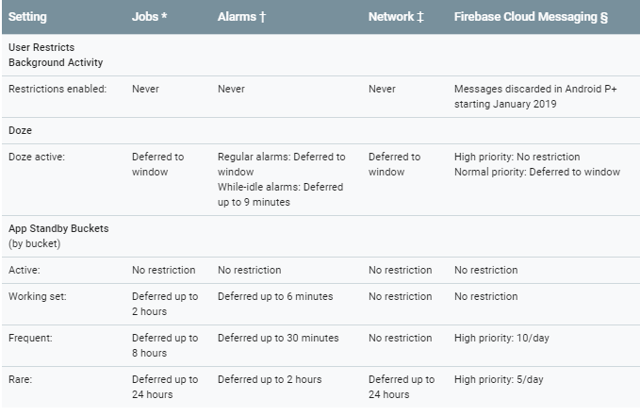
Power Management Restrictions

Slide 11
Exemptions
Developers can use exemptions to apply these settings to their apps.
Users can exempted apps from App Standby and Doze power saving modes in the Settings menu.
Exemptions may be needed in:
Device manufacturers using a Cloud Messaging platform other than Firebase Cloud Messaging(FCM).
Carrier using non-FCM Cloud Messaging platform.
Third-party application using non-FCM Cloud Messaging platform.

Slide 12
Exemptions
Unnecessary exemptions undermine the benefits of Doze and App Standby.
Exemptions allow applications to overcome beneficial controls the platform has over power use and that can lead users to be unhappy about the power consumptions.
Using Exemptions recommended in cloud messaging services or apps with similar functions.

Slide 13
Power Management in Android Applications
Three Important things to keeping app power-thrifty:
Makes app lazy first.
Take advantages of platform features in power management.
Using tools that help identify battery-draining reasons.

Slide 14
Lazy First
Lazy First means looking for ways to reduce and optimize operations that are battery-intensive.
The core questions support Lazy First design:
Reduce: Are there redundant operations your app can cut out?
Defer: Does an app need to perform an action right away?
Coalesce: Can work be batched, instead of putting the device into an active state many times?

Slide 15
Platform Features
Android platform provides 2 categories of help to optimize app’s battery use:
Platform provides several APIs that can be used in app implementation.
Internal mechanisms in the platform that help in save battery life:
Doze and App Standby.
App Standby buckets: System limits apps' access to device resources based on the user’s usage patterns.

Slide 16
Platform Features
Background restrictions: System promote to user to restrict app that have bad behavior from access system resources.
Power management restrictions: List of power restrictions that can be imposed on apps under certain conditions.
Testing and troubleshooting.

Slide 17
Tooling
You can use tools available to identify which parts of your apps consume the most power.
Tools for android:
Profile GPU Rendering
Battery historian

Slide 18
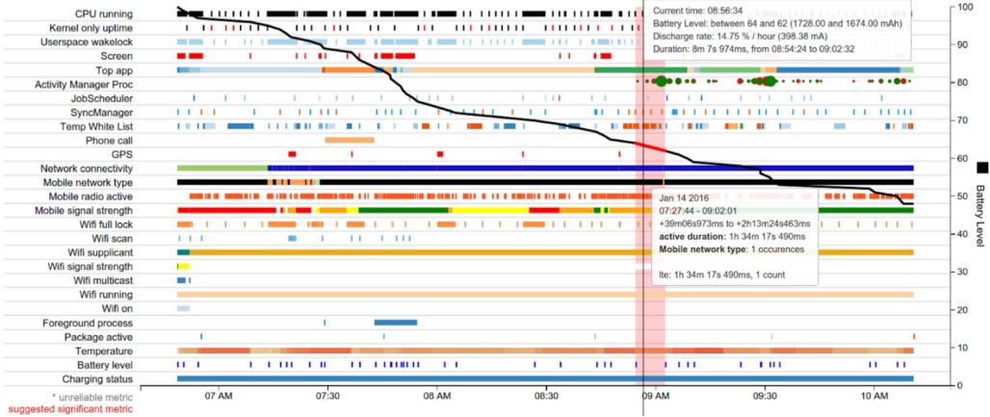
Battery Historian

Slide 19
Improvements in Power Management in Android Pie
Android 9 introduced new features to ensure device power management improvement.
Those features can be divided into two categories:
App standby buckets
Battery saver improvements

Slide 20
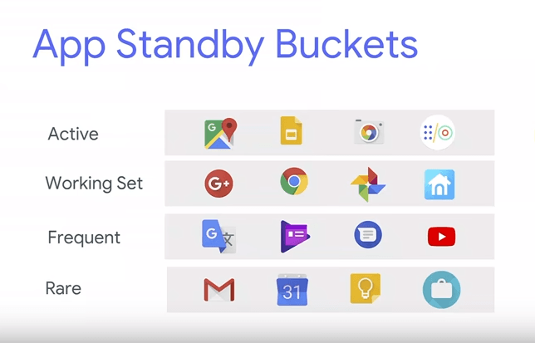

Slide 21
Any questions?

Slide 22
Reference links
https://www.researchgate.net/publication/268004325_Advanced_Android_Power_Management_and_Implementation_of_Wakelocks
https://source.android.com/devices/tech/power/mgmt
https://developer.android.com/topic/performance/power/
https://developer.android.com/about/versions/pie/power

